Slide 1
Topic: Measurement
EQ – How do I find the perimeter of a shape?
Get your VIVO’s
Topic and EQ in Interactive Notebook
NO PHONES OR EAR BUDS
Have a go:
Notes:
In the have a go section wi

Slide 2
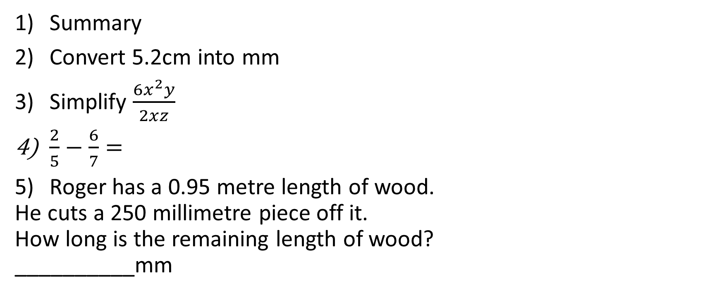
24
7
30
Topic: Measurement
Date
EQ – How do I find the perimeter of a shape?
Summary
Convert 5.2cm into mm
Simplify $\frac{6x^{2}y}{2xz}$
$\frac{2}{5}−\frac{6}{7}=$
Roger has a 0.95 metre length of wood.
He cuts a 250 millimetre piece off it.
How long is the remaining length of wood?
__________mm

Slide 3
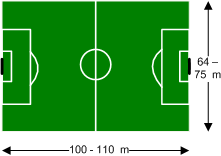
24
7
30
Topic: Measurement
Date
EQ – How do I find the perimeter of a shape?
Glossary Word
Perimeter
Perimeter
Is the distance along the boundary of a shape
Some examples:
A fence is built along the perimeter of a property
A soccer pitch has boundary lines along the perimeter

Slide 4
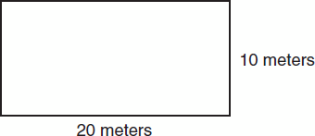
24
7
30
Topic: Measurement
Date
EQ – How do I find the perimeter of a shape?
Method
Rectangle
P = 2l + 2w
Square
P = 4l
Perimeter
To find the perimeter we add up the lengths of the sides.
P = 20 + 10 + 20 + 10
= 60 m

Slide 5
24
7
30
Topic: Measurement
Date
EQ – How do I find the perimeter of a shape?
Perimeter
Or we can use the formula P = 2l + 2w
l = length
w = width
P = 2l + 2w
= 20 x 2 + 10 x 2
= 60 m
Method
Rectangle
P = 2l + 2w
Square
P = 4l

Slide 6
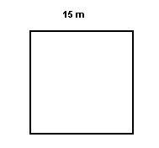
24
7
30
Topic: Measurement
Date
EQ – How do I find the perimeter of a shape?
Method
Rectangle
P = 2l + 2w
Square
P = 4l
Perimeter
P = 15 + 15 + 15 + 15
= 60 m
OR
P = 4 x 15
= 60 m

Slide 7
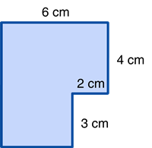
24
7
30
Topic: Measurement
Date
EQ – How do I find the perimeter of a shape?
Method
Rectangle
P = 2l + 2w
Square
P = 4l
Perimeter
First find the length of the
unmarked sides.
a = 6 – 2
a = 4 cm
b = 4 + 3
b = 7 cm
b
a

Slide 8
24
7
30
Topic: Measurement
Date
EQ – How do I find the perimeter of a shape?
Method
Rectangle
P = 2l + 2w
Square
P = 4l
Perimeter
Then add up all the sides
P = 6 + 4 + 2 + 3
+ 4 + 7
P = 26 cm
7 cm
4 cm

Slide 9
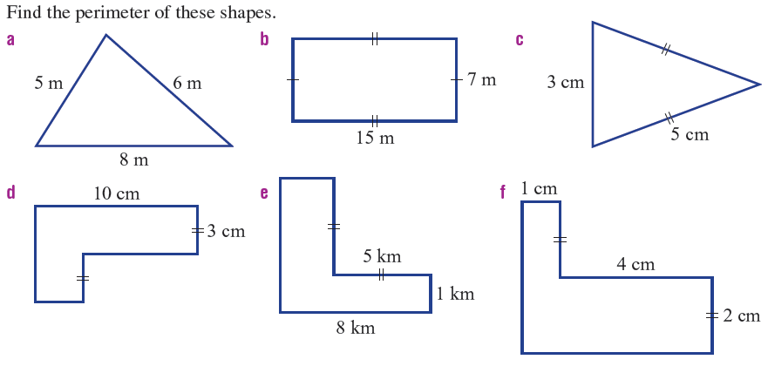
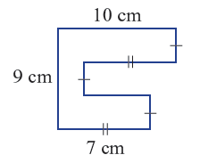
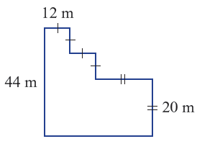
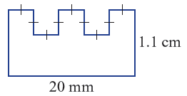
Task- D/C Level

Slide 10
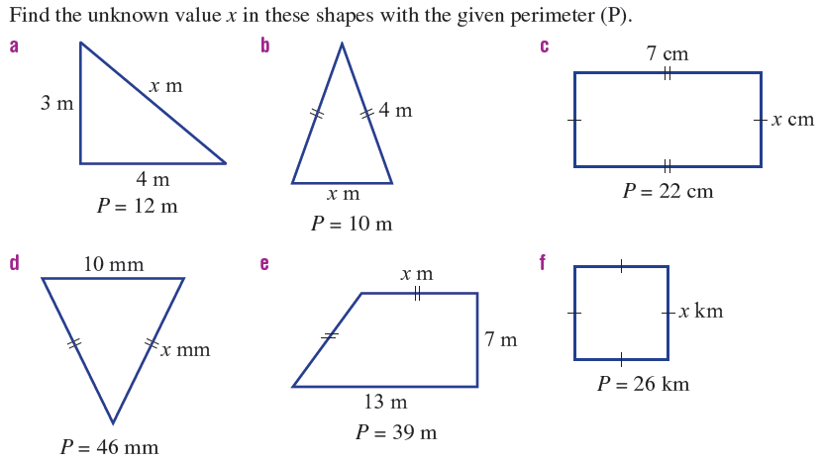
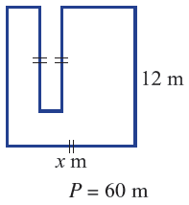
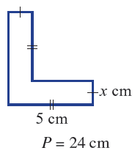
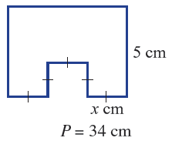
Task- C/B Level

Slide 11
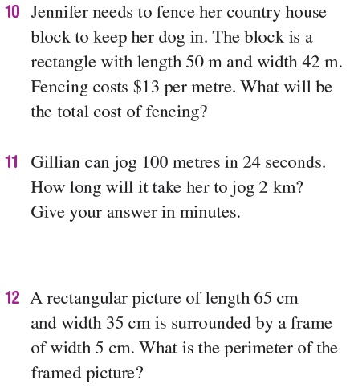
Task B/A Level

